Slide 1
Introduction To Python
By Tooba Ahmed Alvi

Slide 2
ABOUT ME
A Data Science Enthusiast with a Bachelor's in Software Engineering from the NED University of Engineering and Technology. I have 2 years of experience in Data Analytics, Engineering and Sciences.
I am proficient in machine learning and applications; good at solving problems through data.
My expertise includes Python , Tableau, Power BI, and MS Excel.
In my leisure, I prefer to write blogs on Data Science And Machine Learning and love participating in online data contests. I have a keen interest in machine learning and neural networks. I’m always looking forward to an insightful journey related to my skillset to explore new opportunities and learn from them!

Slide 3
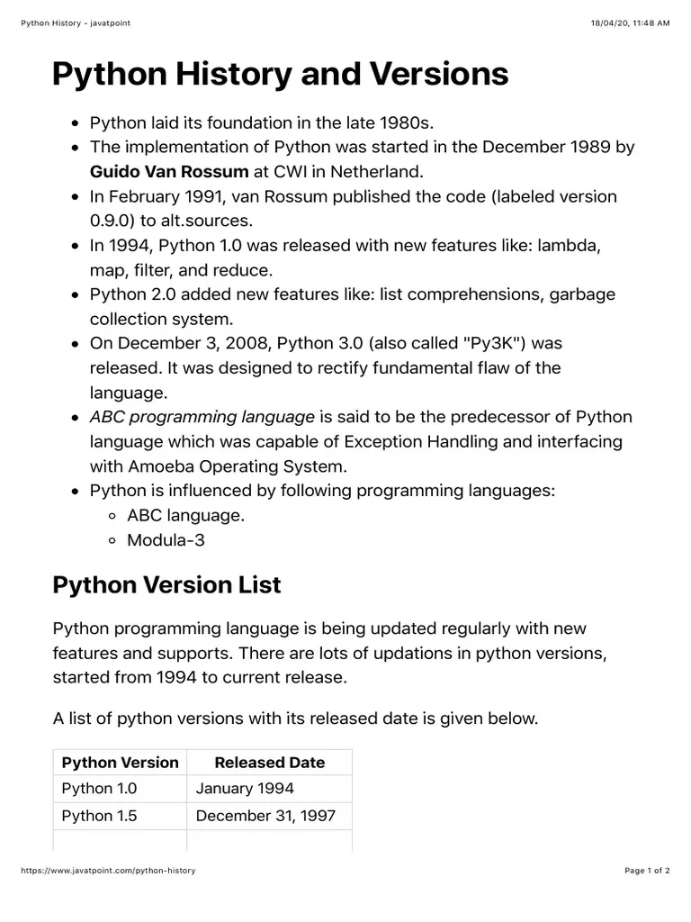

Slide 4
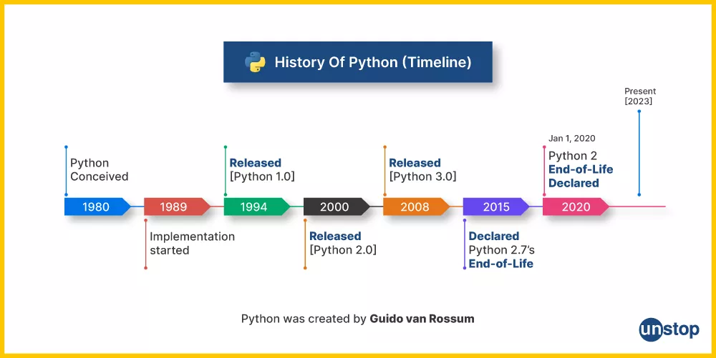
HISTORY OF PYTHON
Python was created by Guido van Rossum, and first released on February 20, 1991. While you may know the python as a large snake, the name of the Python programming language comes from an old BBC television comedy sketch series called Monty Python’s Flying Circus.

Slide 5
WHY TO LEARN PYTHON?
It is easy to learn – the time needed to learn Python is shorter than for many other languages; this means that it’s possible to start the actual programming faster;
It is easy to use for writing new software – it’s often possible to write code faster when using Python;
It is easy to obtain, install and deploy – Python is free, open and multiplatform; not all languages can boast that.
APPLICATIONS:
Web and Internet development (e.g., Django and Pyramid frameworks, Flask and Bottle micro-frameworks)
Scientific and numeric computing (e.g., SciPy – a collection of packages for the purposes of mathematics, science, and engineering; Ipython – an interactive shell that features editing and recording of work sessions)
Education (it’s a brilliant language for teaching programming!)
Desktop GUIs (e.g., wxWidgets, Kivy, Qt)
Software Development (build control, management, and testing – Scons, Buildbot, Apache Gump, Roundup, Trac)
Business applications (ERP and e-commerce systems – Odoo, Tryton)
Games (e.g., Battlefield series, Sid Meier’s Civilization IV…), websites and services (e.g., Dropbox, UBER, Pinterest, BuzzFeed...)

Slide 6
INTEGRATED DEVELOPMENT ENVIRONMENTS
Some widely used IDEs for Python include:
Spyder - Scientific computing IDE
Jupyter Notebook - Interactive Python environment
VS Code - Code Editor
PyCharm - Feature-rich Python IDE
Google Colab - Cloud-based Python notebook.

Slide 7
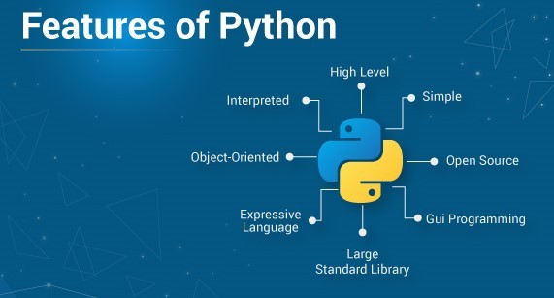
FEATURES OF PYTHON

Slide 8
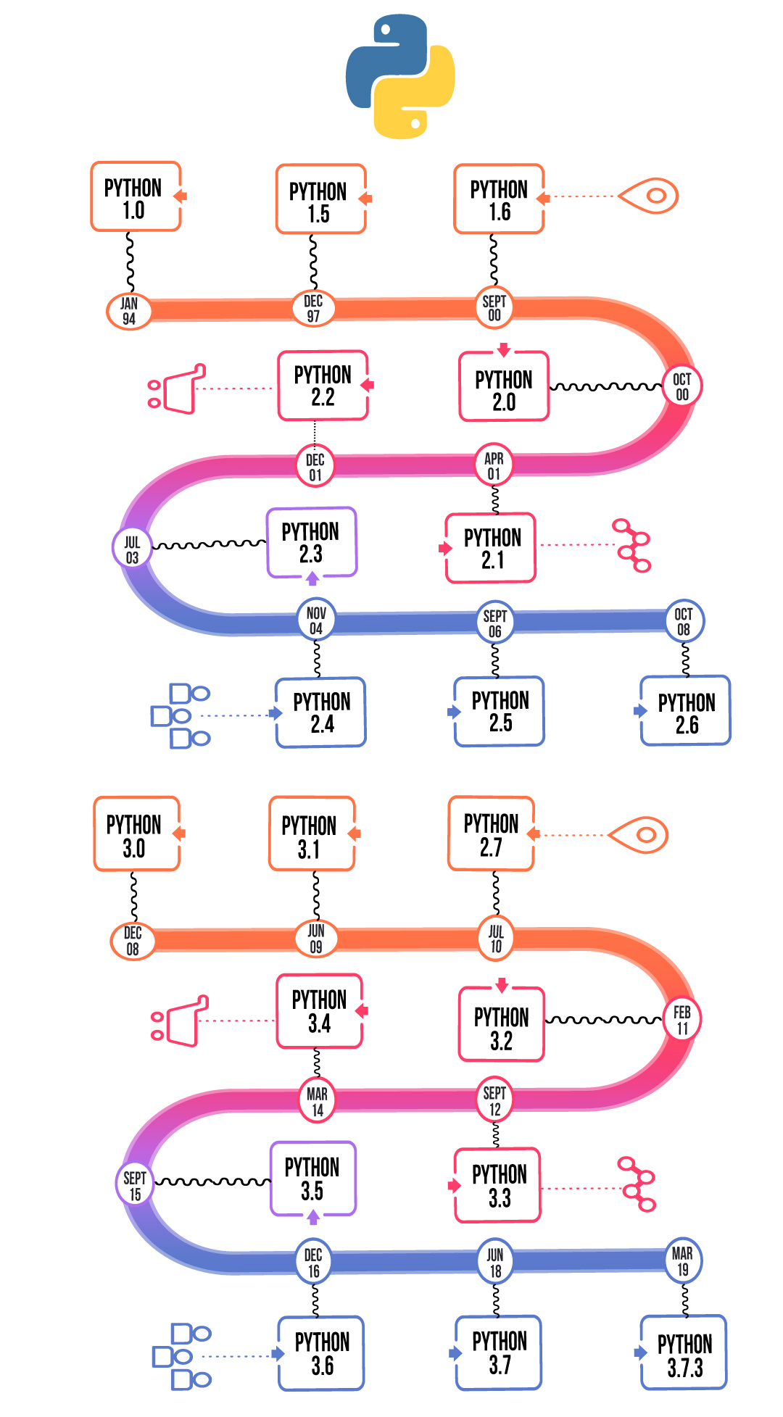

Slide 9
HOMEWORK -DEADLINE NEXT FRIDAY
Explore 10 different libraries in python programming language and write their usage and any built in function.
Compute a basic calculator taking user input and then printing results on screen.
ASSIGNMENT SUBMISSION FORM: https://forms.gle/vustYDSsZfSLAPE28

